Slide 1


Modern Workplace Management - the 101!
Alain Schneiter
Solutions Architect @ make it noble
Blog | blog.alschneiter.com
Twitter | @alschneiter
#ExpertsLiveEU

Slide 2
Session stuff…
Why modern management?
Windows Autopilot
Microsoft Intune
Endpoint what… Endpoint Manager!
Notes:
THR1061-Surface Autopilot The easiest deployment for toda

Slide 3
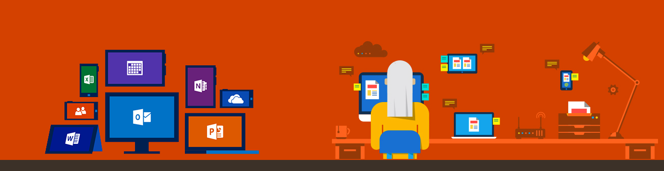
Why modern management?
Notes:
A lot of devices
We’re talking about Windows 10 in this session.
iOS & Android
Not reachable, quick delivering solutions

Slide 4
WINDOWS AUTOPILOT
Notes:
Was und wozu dient AP?

Slide 5
Traditional Windows deployment The old way
Office & apps
Drivers
Policies
Settings
Build a custom image, gathering everything else that’s necessary to deploy
Deploy image to a new computer, overwriting what was originally on it
Time means money, making this an expensive proposition

Slide 6
Modern (Surface) depolyment with Windows Autopilot
Un-box and turn on off-the-shelf Windows PC
Transform with minimal user interaction
Device is ready for productive use
Notes:
Surface or Windows

Slide 7

Autopilot Pre-Reqs
Windows 10
Pro, Pro EDU, Ent, EDU
User synced to AzureAD
Licence assigned to user
Azure AD company branding
Allow users to join devices to Azure AD
Internet access
MDM automatic enrollment

Slide 8
Device life cycle management
^
modern
Intune & AAD
Surface!
Windows Autopilot
Office 365
2
Sync
1
Automated
Partner Center
Microsoft 365
Customer
Intune
Remote wipe, Autopilot reset, etc.
4
Zero touch deployment
Driven by corporate login
Set user privileges
Uplift to Win10 Ent
Configure UEFI/Hardware
Apps & Data
Updates, Features, Settings & Security
MDM Enrolled/Corp directory joined
CSP Partner
Self service
* new / only on Surface
Surface
Re-provisioned
5
Full life cycle management
End of life (Deprovisioned)
3
On demand / direct
Steady state usage
Warranty replacement
Fulfill and deliver
Employee
Notes:
How helps Microsoft 365 to lifecycle, manage & deploy Windows devices

Slide 9
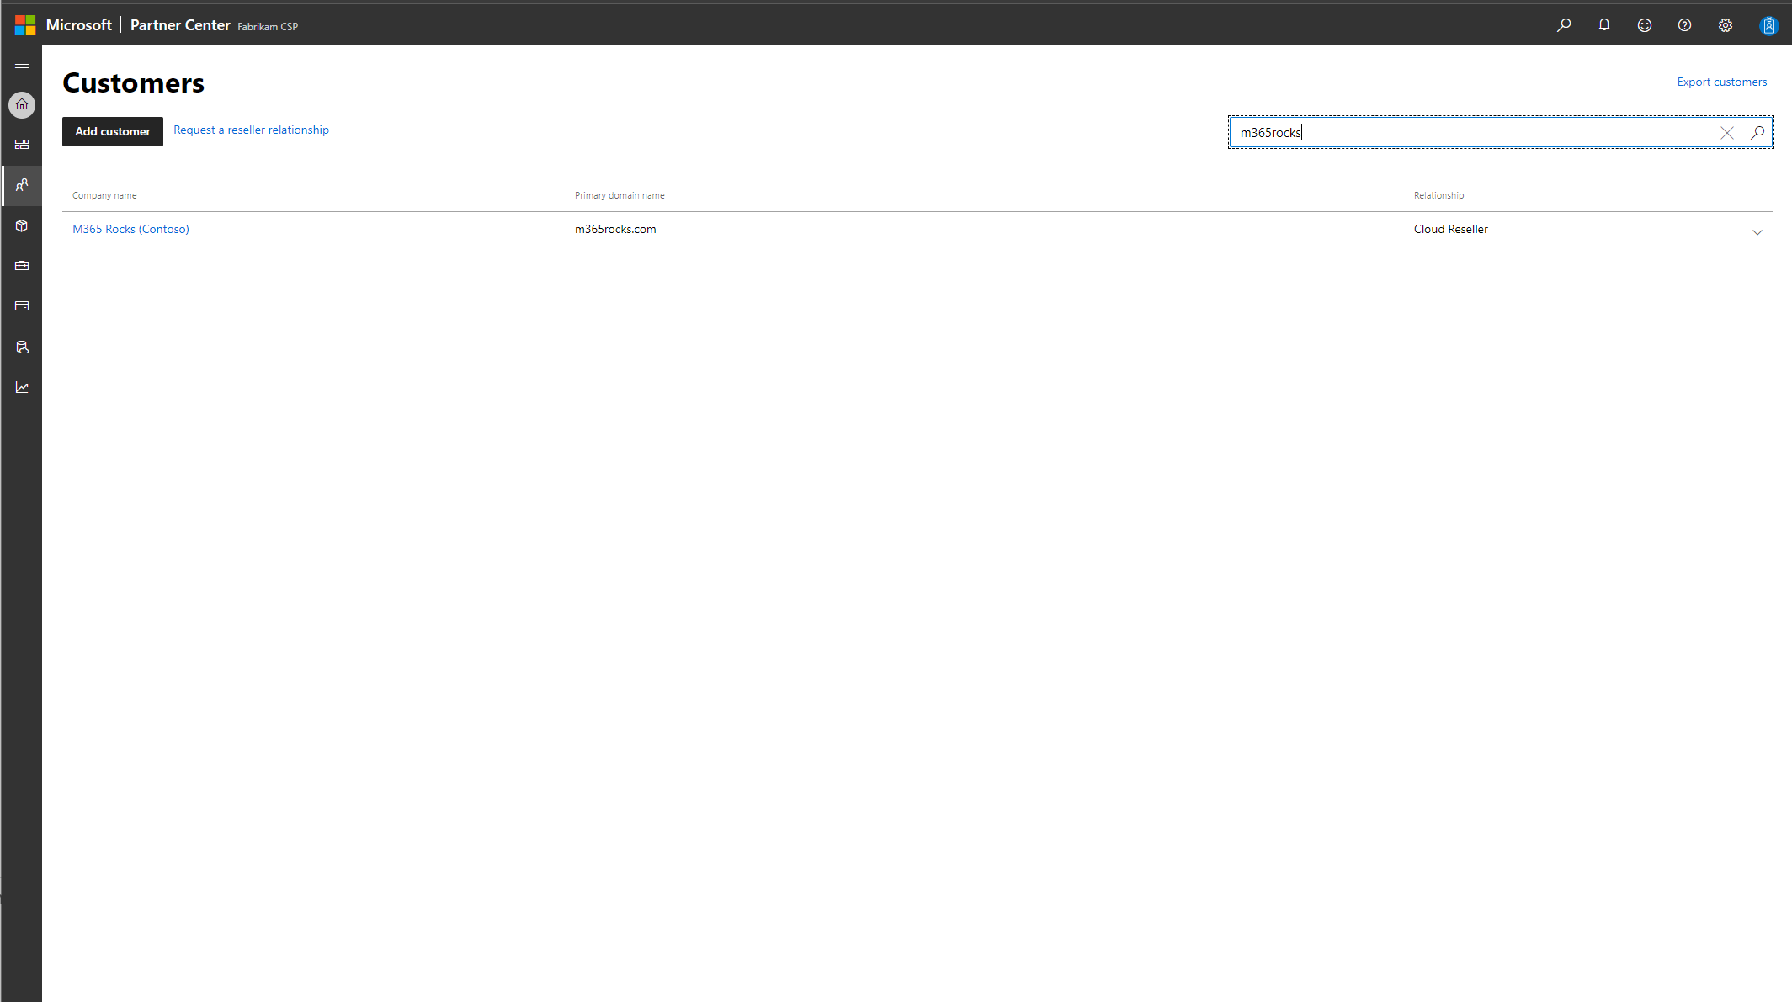
Notes:
Device registration
As a CSP Partner or customer
Vendor access to the portal
Select customer

Slide 10
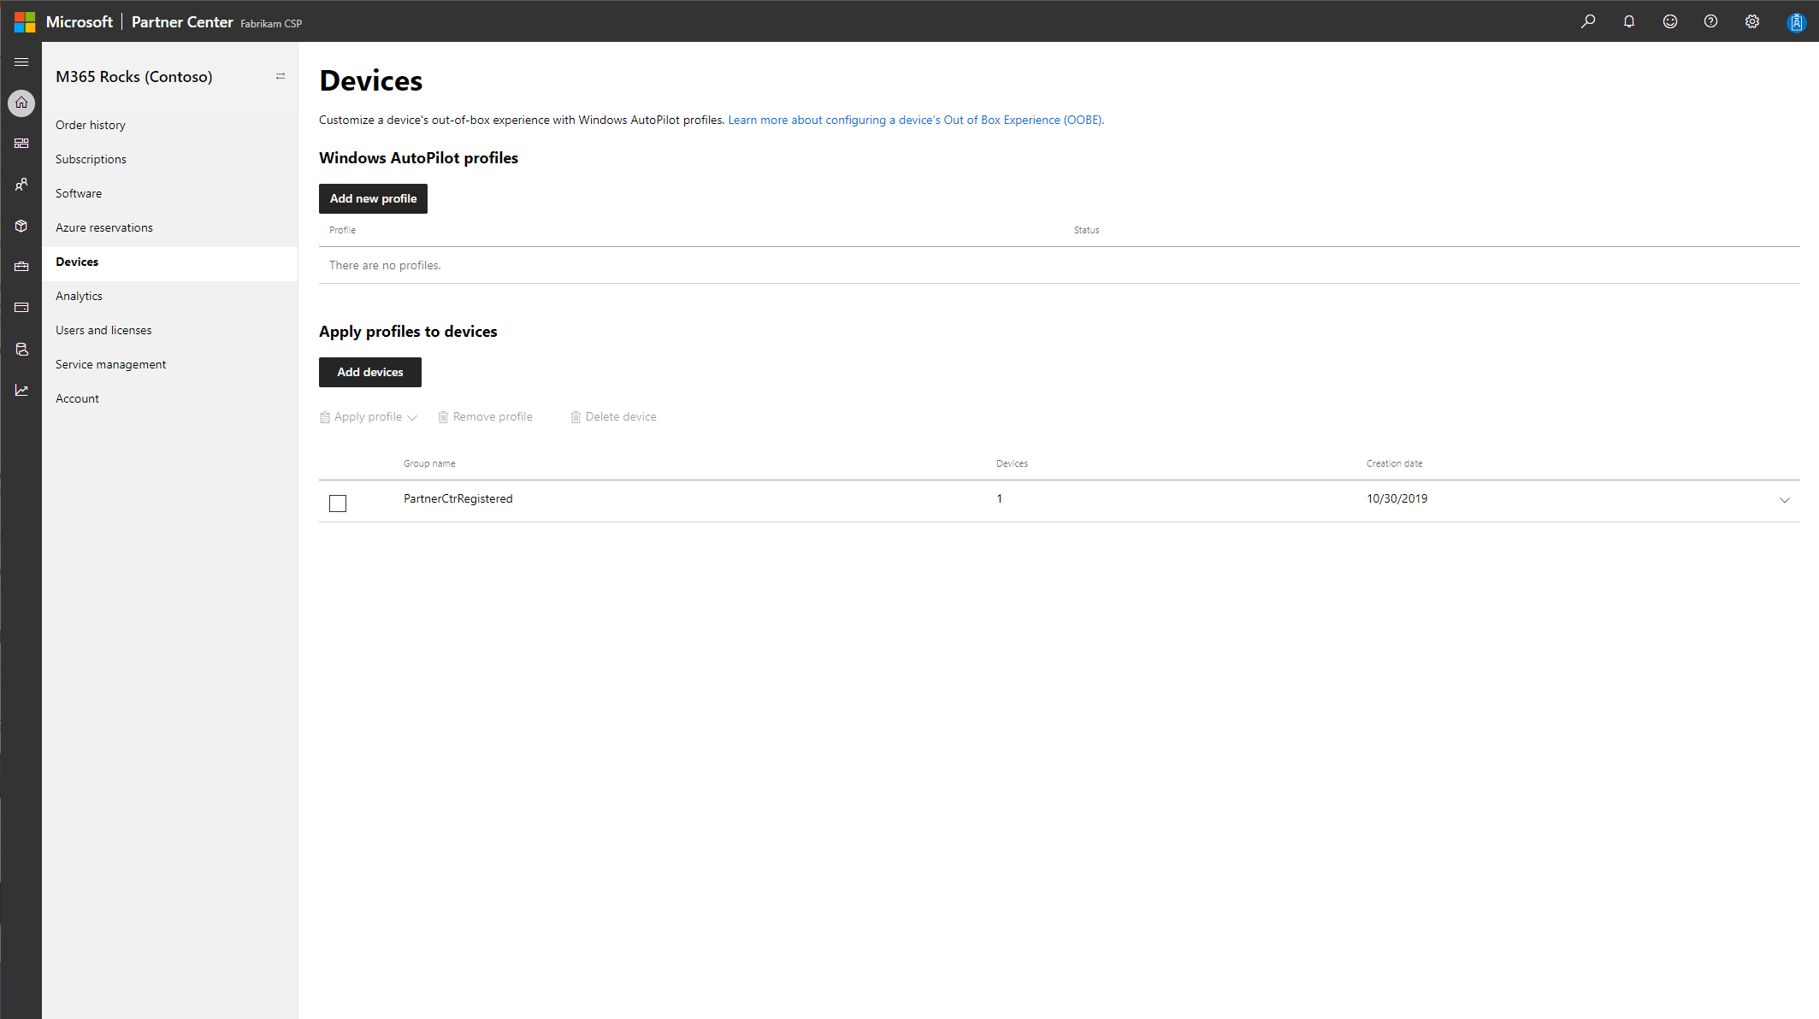
Notes:
Add devices

Slide 11
Notes:
Get-AutoPilotDevice | Where-Object {$_.groupTag -eq "PartnerCtrRegistered"}

Slide 12
News!
Public Preview stuff
Windows 10 feature updates (this week!)
Guided scenarios
Policy sets
Surface UEFI Management
Microsoft EDGE Baselines
On Roadmap
Change GroupTag
Edit Autoipilot device name
Unified audit log
Endpoint Manager
Notes:
https://techcommunity.microsoft.com/t5/Intune-Customer-Success/Upcoming-change-to-Audit-logs-in-Intune/ba-p/1015858
unified audit log experience, centralizing Audit logs
https://docs.microsoft.com/en-us/intune/fundamentals/whats-new#windows-10-feature-updates-public-preview

Slide 13
A look under the hood
Device Registration, Policy Sets (Preview), Surface UEFI Management (Preview),
Office & Apps, Remote Device Actions
Notes:
Device Firmware Configuration Interface (DFCI)
https://github.com/rzander/ruckzuck/wiki/RuckZuck-for-Intune

Slide 14
Autopilot «White Glove»

Slide 15
Windows Autopilot // before 1903
Windows image and drivers
Apply apps, settings, policies
OEM
(minutes)
End User
(minutes to hours)
Dependent on:
Network speed
User expectations / patience

Slide 16
Windows Autopilot // with white glove in Windows 10 1903 and later
Windows image and drivers
User settings, policies
Device apps, settings, policies; User apps
OEM
(minutes)
OEM, Partner, or IT
(minutes to hours)
Optimized for:
Network speed (caching)
Multitasking
End User
(minutes)

Slide 17





Pre-reqs
Windows 10 1903 (Pro, Ent, Edu)
LAN Connection (Wlan trick)
HW only (no VM Support)
TPM 2.0 & device attestation
Policies:
Device targeted Win32 / LOB Apps
User targeted
From OOBE 5-times -button
Notes:
https://github.com/Microsoft/WindowsAutopilotCompanion
start ms-settings:
Compliance Policy
DHA policy checks the following boot configuration or attributes:
Secure boot
Bitlocker
Early launch malware
Code Integrity

Slide 18
White glove experience

Slide 19
Microsoft Endpoint Manager

Slide 20
Microsoft Ignite 2019
“Use the power of cloud intelligence to simplify and accelerate IT and the move to a modern workplace” – Brad Anderson, Corporate Vice President for Microsoft 365
“Co-management isn’t a bridge; it’s a destination” – Brad Anderson, Corporate Vice President for Microsoft 365
Notes:
Two statements
- From Corporat VP for M365
https://www.microsoft.com/en-us/microsoft-365/blog/2019/11/04/use-the-power-of-cloud-intelligence-to-simplify-and-accelerate-it-and-the-move-to-a-modern-workplace/

Slide 21
Licensing to #MEMCM
To make this easier for you as well, we're also announcing today that we're simplifying licensing, and we are making the licensing to Intune available to all ConfigMgr customers to co-manage your Windows devices.

Slide 22
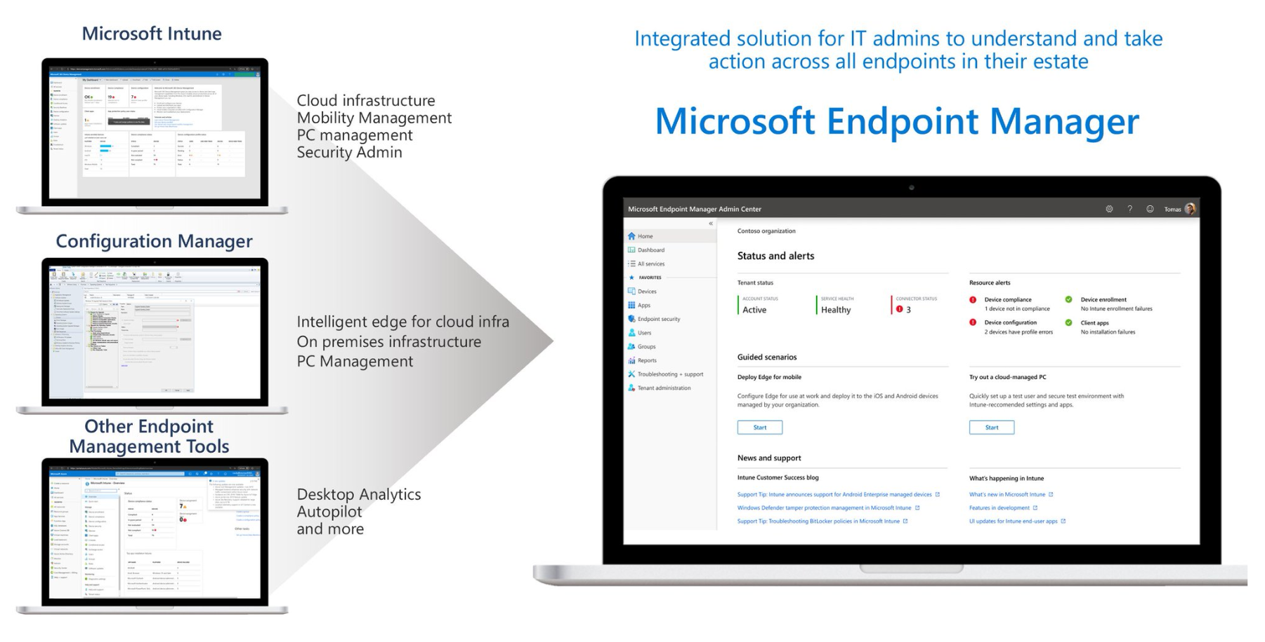
What’s MEM?

Slide 23
Key takeaways
Device lifecycle management
Best for Surface
Prepare Windows with «White glove»
#MEM - Single console for all managed devices
Notes:
Lifecycle
- CSP; Retire, Wipe, Reset

Slide 24
#BYOQ

Slide 25














Thank you Sponsors!

